Slide 1
Mathematics IN Health Care Analytics
By: Marifel Ocasio
UMASS Memorial Health Care
Office of Clinical integration

Slide 2
Agenda
Introduction
“A Little About Me”
UMass Memorial Medical Center
Office of Clinical Integration
Career in Data Analytics
What is Population Health?
How high school math applies to health care analytics?
Sample Report

Slide 3
A Little About ME
1991
Born in Manhattan, NYC
1999
Moved to Worcester, MA & attended Jacob Hiatt
Currently
Manager of Population Health Reporting and Analytics at OCI
2002-2005
Forest Grove Middle School
2005-2009
South Community High School
2009 - 2013
Clark University
Worcester, MA
2013
Full Time Data Analyst at OCI
2012
Interned at OCI
2006 - 2009
Part of Bruce Wells Scholars Upward Bound Program
2015-2016
Received the Senior Data Analyst Position at OCI

Slide 4
Umass memorial medical center
One of the largest health care systems in Central Massachusetts
Partnered with the UMass Medical School
Hospitals:
UMass Memorial Medical Center
Clinton Hospital
Health Alliance Hospital
Marlborough Hospital
Fully accredited by the Joint Commission
UMass Memorial Health Care by the numbers:
1,600 physicians on our active medical staff
3,000 registered nurses
12,000 total employees
1,125 beds in our hospitals
Provide a variety of services from Heart & Vascular Care to Emergency Medicine & Trauma
Other areas:
UMass Memorial Medical Group
UMass Memorial Medicare Accountable Care Organization
(UMass Medical School, n.d.)

Slide 5
Umass Mission, Vision, and values

Slide 6
Office of clinical Integration
The Office of Clinical Integration focuses on supporting the UMMHC system and geographically affiliated physician groups, independent practices, and community organization to successfully manage the population of patients insured by public and private prayers
What constitutes the Office of Clinical Integration:
Administrative Team
Data Quality and Integrity
Medicare ACO Operations
Medicare ACO Care Management Team
Medicaid ACO Care Management Team
Practice Improvement Facilitators
Population Health Reporting and Analytics
Senior Leaders

Slide 7
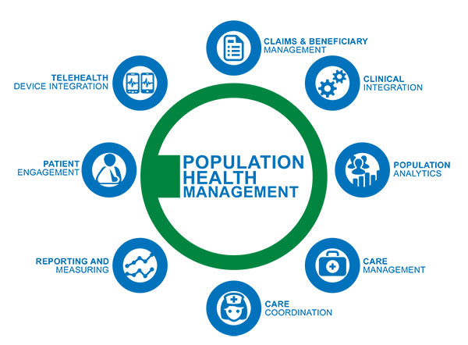
What is Population Health?
(BHM Marketing, n.d.)
Notes:
“Population Health Management is the aggregation of patient data across multiple health information technology resources, the analysis of that data into a single, actionable patient record, and the actions through which care providers can improve both clinical and financial outcomes.”

Slide 8
Career In population health data analytics
Technical Skills
SQL/SAS
Statistical tool – SPSS
Visualization Tool – Tableau
Microsoft Office Package
Personal Skills
Ability to work independently as well as with others
Attention to detail
Methodical and Logical thinking
Ability to quickly do simple math
(RADCube, 2017)

Slide 9
How high school math applies to health care analytics?
Statistical Methods and algorithms are used to better analyze patient information. This has allowed for better prediction of patient outcome which has helped with the management of patients and improving the quality of life of patients.
Statistical methods also help with decision making and developing processes to support the operational needs of an organization
Areas where statistics has been used:
Identifying high risk and high cost patients
Developing a new method of calculating physicians reward in the quality incentive program
Identifying the appropriate sample size for collection of patient data
All areas of mathematics requires logical and methodical thinking something that is also crucial in healthcare analytics.

Slide 10
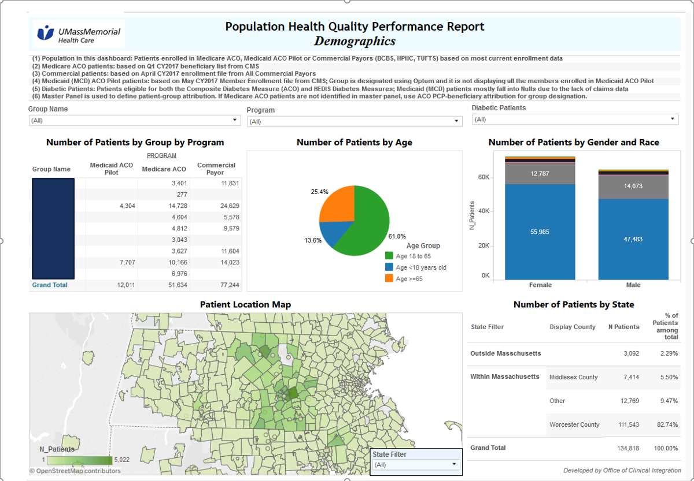
Sample Report

Slide 11
Final Remarks
Important to have the ability to do quick math
Understanding the end goal
Learn to understand the needs of your customers
Understanding of simple statistical functions (e.g. ratios, formulas, etc.)
(Young Scholars Educational Enrichment Program & Services , n.d.)

Slide 12
Work Cited
BHM Marketing. (n.d.). Population Health Management Challenges. Retrieved from BHM Healthcare Solutions: http://bhmpc.com/2015/06/population-health-management-challenges/
Philips. (n.d.). What is population health management? Retrieved from Wellcentive: https://www.wellcentive.com/what-is-population-health-management/
RADCube. (2017, April 05). Data Analytics – Enterprise Data Solutions. Retrieved from RADCube: http://www.radcube.com/portfolio/data-analytics-enterprise-data-solutions/
UMass Medical School. (n.d.). UMass Memorial/University Campuses. Retrieved from UMass Medical School: http://www.umassmed.edu/studentaffairs/curriculum/affiliate-sites/umass-memorial/
UMass Memorial Health Care. (n.d.). ABOUT US. Retrieved from UMass Memorial Health Care : https://www.umassmemorialhealthcare.org/about-us
Winters-Miner, L. A. (2014, October 06). Seven ways predictive analytics can improve healthcare. Retrieved from Elsevier: https://www.elsevier.com/connect/seven-ways-predictive-analytics-can-improve-healthcare
Young Scholars Educational Enrichment Program & Services . (n.d.). High School Programs . Retrieved from Young Scholars SEC: http://www.youngscholarsec.com/high-school

Slide 13
Questions

